Slide 1
Social Networking Website

Slide 2
Group-15
Team Members:
Sakshi Soni (Team Lead)
Harshita Bora
Cyril Peter
Garima Soni
Gaurav
Anchal Vaish
Badal Sahu
Gowtham V
Swati Ubnare

Slide 3
Table Of Contents
Introduction……………………………………………. 4
1.1 Purpose…………………………………………….. 5
1.2 Scope………………………………………………… 6
System Description…………………………………. 8
2.1 Technologies Used……………………………. 8
2.2 Tools Used………………………………………… 10
Screenshots……………………………………………. 11

Slide 4
1. Introduction
A social networking site is an online platform that allows users to create a public profile and interact with other users. Social networking sites usually allow a new user to provide a list of people with whom they share a connection, and then allow the people on the list to confirm or deny the connection. After connections are established, the new user can search the networks of connections to make more connections.
A social networking site is also known as a social networking website or social website.

Slide 5
1.1 Purpose
Social networking connects individuals and businesses by allowing them to share information, ideas, and messages. Companies also use social networks to create and strengthen brand recognition, promote products and services, and answer customer queries and concerns.
The benefits of social networks include their ability to help people connect and stay in touch with family, friends, and new contacts; the opportunity they offer businesses to market their brands; their ability to spread useful, even vital, information instantly to individuals and institutions.
Social networks are important because they allow people to develop relationships that might not be possible due to distances of place and time. They also helps boost business productivity when used for public relations, marketing, and advertising purposes.

Slide 6
1.2 Scope
Shopping will become more common on social media channels.
Social media sites operating within specific verticals will have increasing success, such as sport, finance, automotive, music, film and other large-volume opportunities.
Social pages will become more conducive to enabling customers to respond directly without creating potential brand damage.
Creating and sharing media will become increasingly easy as wearable technology becomes mainstream.
Businesses will get smarter about how they use social. No longer shouting about their greatness, they will develop strong content strategies and have unique strategies for each social channel, only operating on the channels that are relevant.

Slide 7
1.2 Scope
People will use social media more to partake in crowd-based activities with individuals that they don’t know but do have things in common with. Crowdfunding and peer-to-peer lending opportunities will grow. The world will increasingly become one community.
SMS text messaging will virtually disappear, perhaps only remaining for emergencies, as messaging apps take over.
Cloud content will increase as people become comfortable with the concept and begin to release their psychological attachment to ownership. This will further enable sharing.

Slide 8
2. System Description
2.1 Technologies Used
JAVA: Programming Interface
Java is a high-level, class-based, object-oriented programming language that is designed to have as few implementation dependencies as possible. It is a general-purpose programming language intended to let programmers write once, run anywhere (WORA), meaning that compiled Java code can run on all platforms that support Java without the need to recompile.Java applications are typically compiled to bytecode that can run on any Java virtual machine (JVM) regardless of the underlying computer architecture. The syntax of Java is similar to C and C++, but has fewer low-level facilities than either of them. The Java runtime provides dynamic capabilities (such as reflection and runtime code modification) that are typically not available in traditional compiled languages.

Slide 9
As of 2019, Java was one of the most popular programming languages in use according to GitHub, particularly for client–server web applications, with a reported 9 million developers.Java was originally developed by James Gosling at Sun Microsystems.
HTML
CSS
JavaScript
XML
JSON
SQL

Slide 10
2.2 Tools Used
JDK (Java Development Kit)
Eclipse IDE
My SQL
Apache Tomcat

Slide 11
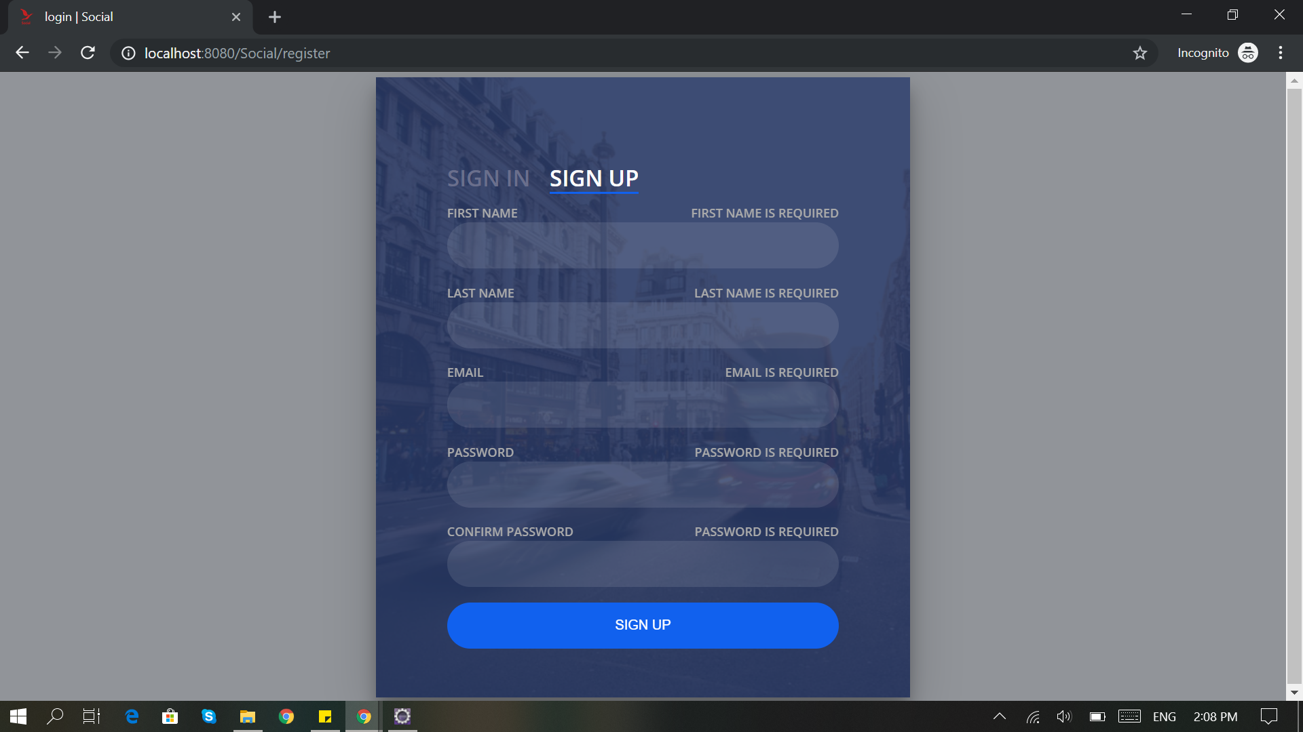

Slide 12
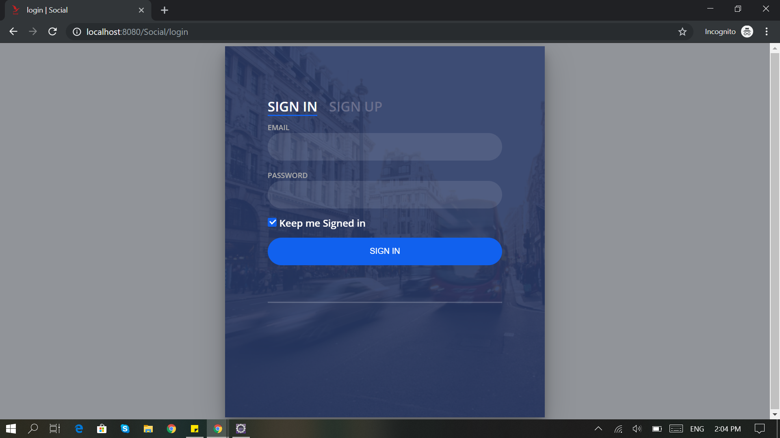

Slide 13
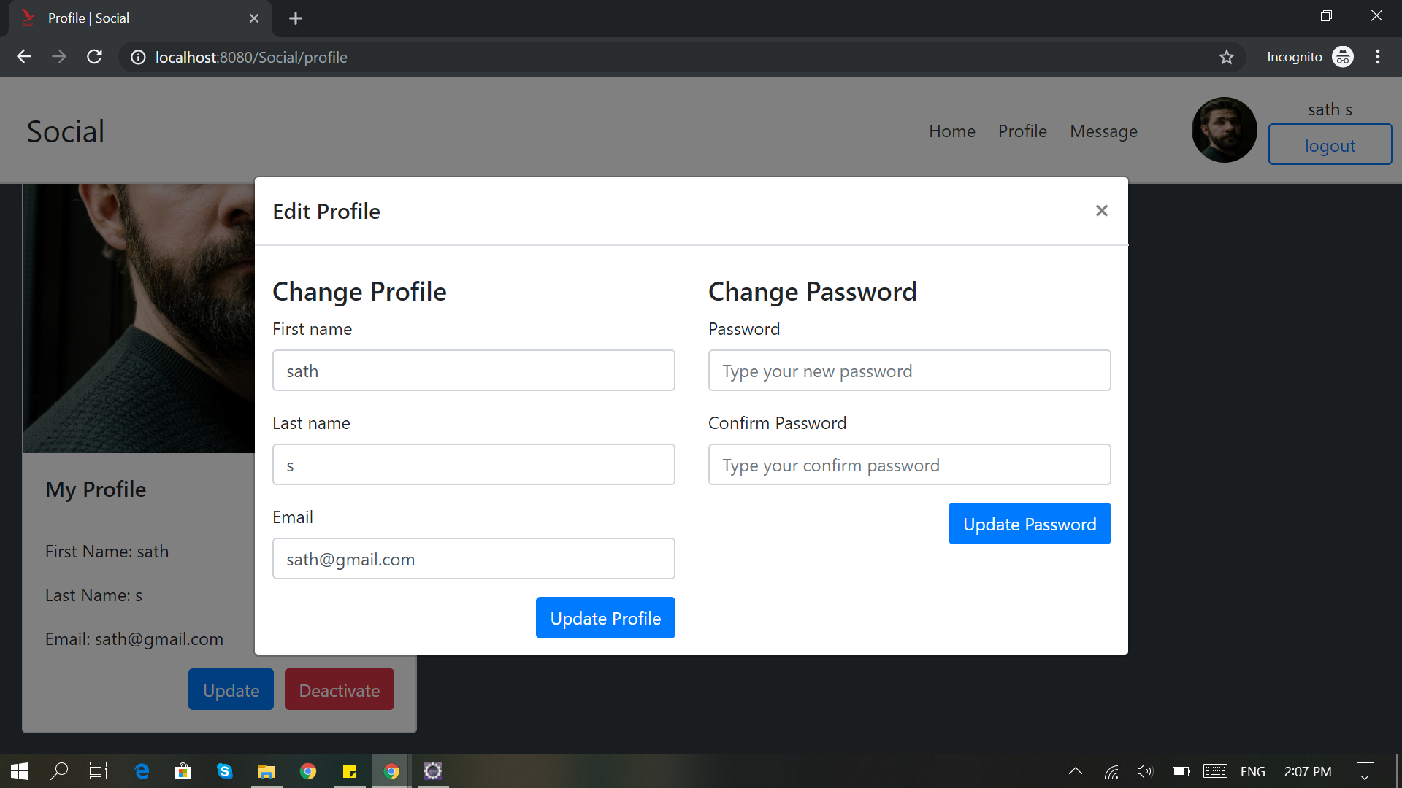

Slide 14
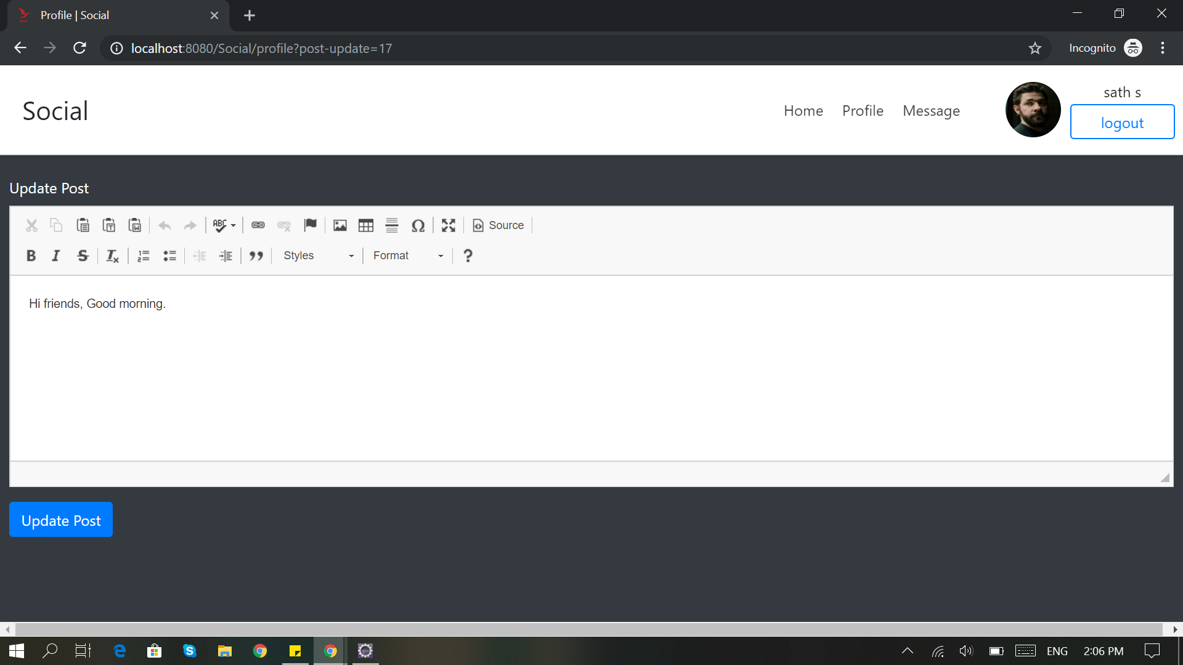

Slide 15
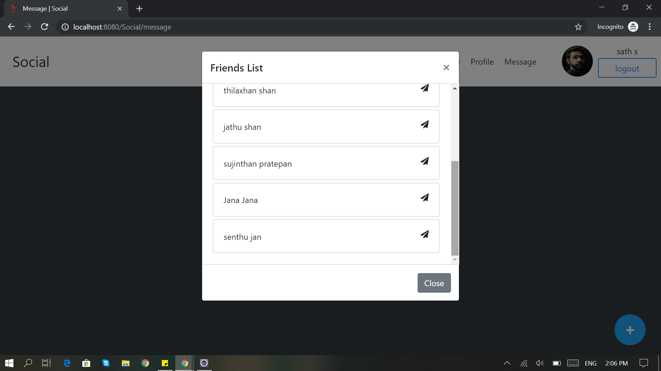

Slide 16
Thank you !

